Slide 1
MULTI DOCUMENT SUMMARIZATION (FOR NEWS ARTICLES)
Under the guidance of Prof. Sudip Sanyal

Slide 2
Team Members
Gaurav Kumar Chandel (IIT2012056)
Ritesh Kumar Sinha (IIT2012003)
Nithin Srikar Karnala (IIT2012014)
Atul Kumar Verma (IIT2012036)
Mohit Purbey (IIT2012055)
Harivansh Kumar (IIT2102026)

Slide 3
Problem?!
User(Say a very busy guy) wants to read news about a certain topic.
He visits various websites desperately searching for that topic.
Wastes a lot of time reading a lot of redundant information across various websites.
At the end of the day remains unsatisfied.
Solution: Why can’t we summarize the information available across various websites and give our guy the compact summary.

Slide 4
How to obtain extractive summary?
Sentences are extracted on the basis of sentence salience.
Method 1 – Centroid Based:
Create a centroid of document cluster that contains central words i.e., words having tf × idf values greater than a threshold.
Sentence that contains more words from centroid is considered more salient.

Slide 5
How to obtain extractive summary?
Method 2 – Graph Based:
Create a graph in which each node represents a sentence and each edge represents similarity between two sentences.
The nodes having higher degree are considered more salient.

Slide 6
How to obtain extractive summary?
The hybrid centrality of each sentence is calculated as the weighted sum of the above two methods.
The sentences having more hybrid centrality are considered more salient.

Slide 7
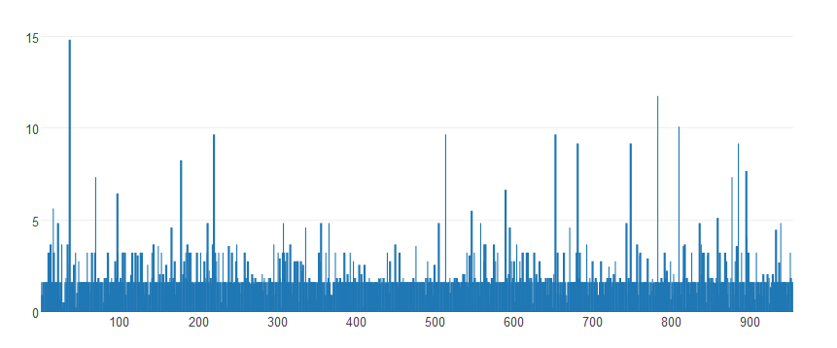
Results
Fig. 1 – Bar plot of tf x idf values for Net Neutrality data

Slide 8
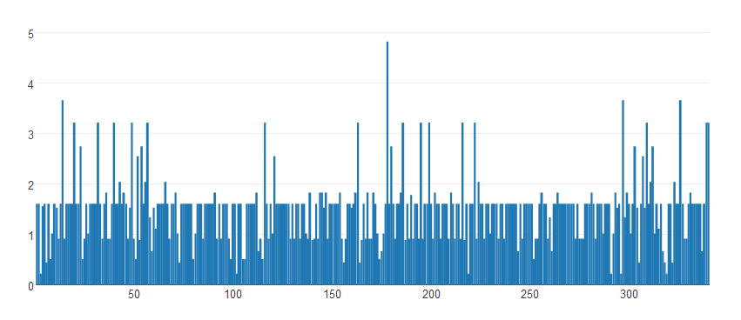
Results
Fig. 2 – Bar plot of tf x idf values for Farmer Suicide data

Slide 9
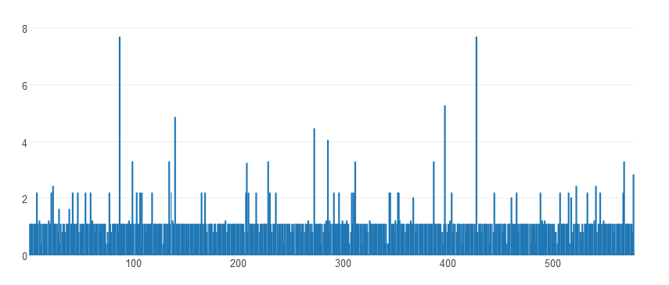
Results
Fig. 3 – Bar plot of tf x idf values for Yemen Crisis data

Slide 10
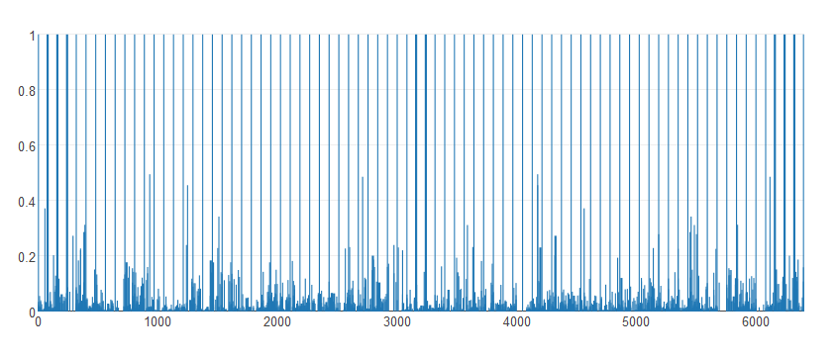
Results
Fig.4 – Bar plot of cosine similarity values for Net Neutrality data

Slide 11
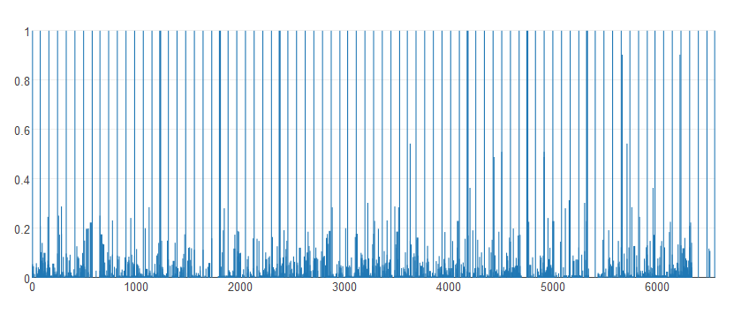
Results
Fig. 5 – Bar plot of cosine similarity values for Farmer Suicide data

Slide 12
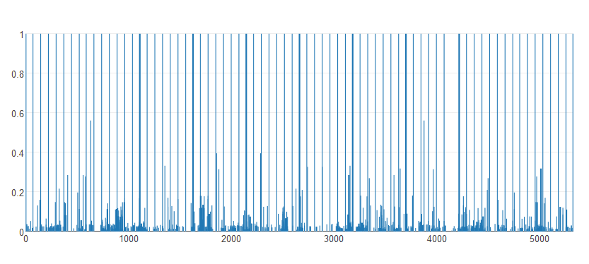
Results
Fig. 6 – Bar plot of cosine similarity values for Yemen Crisis data

Slide 13
Results
From analyzing the above graphs the minimum and maximum threshold values for tf x idf that are found to be optimal are –
Min tf x idf = 0.9
Max tf x idf = 2.8
From analyzing the above graphs the optimal value of cosine similarity threshold is found to be –
CosineSimilarityThreshold = 0.05

Slide 14
Results
We also experimented with various values of α (Centroid Based Method ranking weight) and β(Graph Based Method ranking weight) and found that the following values give the best results.
α = 0.5
β = 0.5

Slide 15
Thank You ☺

